Slide 1
RDA/Chronic OOC AD Introduction
F10 Data Science
Tan Peng/ Siqi/ Kaiqin

Slide 2
Agenda
Triggering Rule
Data Source
SPACE
Sigma
SWR
QDR
PM/CM Lead Lot
Lot Attribute
Analysis Flow
Analysis Method
FMEA List
Domain knowledge
Past Feedback
Last OOC Check
Time Weighted Correlation
Report
Sections
Report Features
Dashboard
Future Roadmap

Slide 3
Triggering Rule
RDA OOC AD
Currently, for RDA AD, we will query past 24 hours and check whether any new OOC points.
To analyze a chart, below criteria must meet:
chart has minimum 1 point within 24 hours
chart has minimum 2 OOC points and 2 good points in same chart type
chart type is mean, sigma, range and ewma-mean.

Slide 4
Triggering Rule
Chronic OOC AD
For Chronic OOC AD triggering, we use Chronic OOC chart list from SPC team.
for multiple chart type highlighted in the Chronic OOC chart list, the chart type with most OOC points will be analyzed by AD
To analyze a chart, below criteria must meet:
Chart is in SPC Chronic OOC highlight list.
Chart has minimum 2 OOC points and 2 good points in same chart type for past 30 days.
Chart type is mean, sigma, range and ewma-mean.

Slide 5
Data Source

Slide 6
Data Source
SPACE Data
AD currently use Global Data Warehouse (GDW) SPACE data source from hive table.
Databases:
prod_mti_{region}_fab_{fab}_spc_dm
Tables:
prod_mti_{region}_fab_{fab}_spc_dm.T_EXT_SAMPLES_VIOL
prod_mti_{region}_fab_{fab}_spc_dm.t_channel_def
prod_mti_{region}_fab_{fab}_spc_dm.t_ext_samples_wafer
prod_mti_{region}_fab_{fab}_spc_dm.t_ext_samples_lot
prod_mti_{region}_fab_{fab}_spc_dm.t_ext_samples_calc
Query Method:
PySpark

Slide 7
Data Source
Sigma Data
AD currently use Global Data Warehouse (GDW) Sigma data source from HBase table.
Databases:
prod_mti_singapore_fab_10_sigma
Tables:
prod_mti_singapore_fab_10_sigma:sigma_lot_v2
prod_mti_singapore_fab_10_sigma:sigma_wafer_v2
prod_mti_singapore_fab_10_sigma:sigma_measurement_v2 (for future usage)
Query Method:
HBase Thrift Server (python)

Slide 8
Data Source
SWR Data
AD currently use Global Data Warehouse (GDW) SWR data source from Teradata table.
Databases:
FAB_{fab}_SWR_DM
Tables:
FAB_{fab}_SWR_DM.SWR_LOT
FAB_{fab}_SWR_DM.SWR
FAB_{fab}_SWR_DM.SPLIT_DEFINITION
FAB_{fab}_SWR_DM.SPLIT_GROUP
FAB_{fab}_SWR_DM.TRAV_DEF_FOR_GROUP
FAB_{fab}_REF_DM.STEP
FAB_{fab}_SWR_DM.WAFERS_IN_SPLIT
Query Method:
python

Slide 9
Data Source
QDR Data
AD currently use Global Data Warehouse (GDW) QDR data source from Teradata table.
Databases:
FAB_{fab}_QDR_DM
WW_MFG_DM
Tables:
FAB_{fab}_QDR_DM.QDR_WAFER
FAB_{fab}_QDR_DM.QDR_TEXT
FAB_{fab}_QDR_DM.QDR_HEAD
WW_MFG_DM.d_Step
Query Method:
python

Slide 10
Data Source
PM/CM Lead Lot Data
AD currently use Global Data Warehouse (GDW) QDR data source from Teradata table.
Databases:
WW_MFG_IDS_DM / WW_MFG_DM / FAB_{fab}_FT_DM
Tables:
Obtain pm/cm information
WW_MFG_IDS_DM.ET_EVENT_HISTORY
WW_MFG_IDS_DM.ET_EQUIPMENT
WW_MFG_IDS_DM.ET_EQUIPMENT_state_for_area
WW_MFG_IDS_DM.REF_MFG_AREA
WW_MFG_IDS_DM.ET_EVENT_CODE_HISTORY
WW_MFG_IDS_DM.ET_EVENT_NOTE
Obtain lot information
WW_MFG_DM.d_LotStepMES
FAB_{fab}_FT_DM.FAB_LOT_HIST
FAB_{fab}_FT_DM.FAB_LOT_EQUIP_HIST
Query Method:
Python

Slide 11
Data Source
Lot Attribute Data
AD currently use Global Data Warehouse (GDW) lot attribute data source from Teradata table.
Databases:
FAB_{fab}_FREC_DM
FAB_{fab}_REF_DM
WW_MFG_IDS_DM
Tables:
Obtain step information
FAB_{fab}_FREC_DM.exception
FAB_{fab}_FREC_DM.exception_member
FAB_{fab}_FREC_DM.attr
FAB_{fab}_FREC_DM.process_exception
FAB_{fab}_FREC_DM.process
FAB_{fab}_REF_DM.step
FAB_{fab}_REF_DM.corr_item
Obtain lot information
WW_MFG_IDS_DM.FT_FAB_LOT_ATTR_VALUE
WW_MFG_IDS_DM.REF_CORR_ITEM
Query Method:
python

Slide 12
Analysis Method

Slide 13
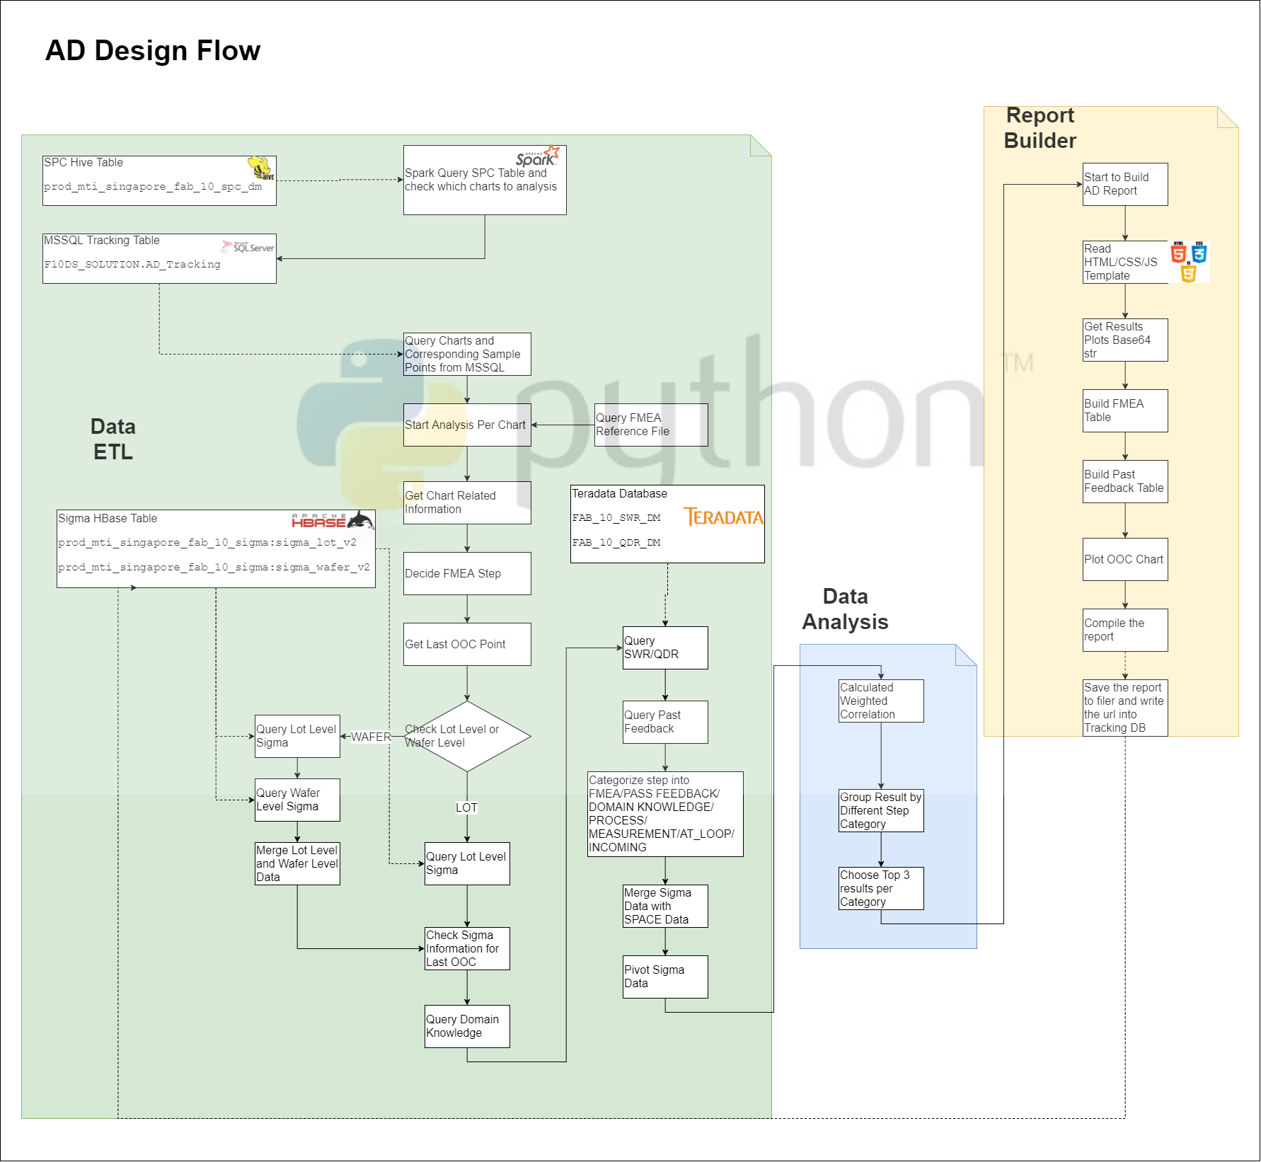
Analysis Flow
Overall Design

Slide 14
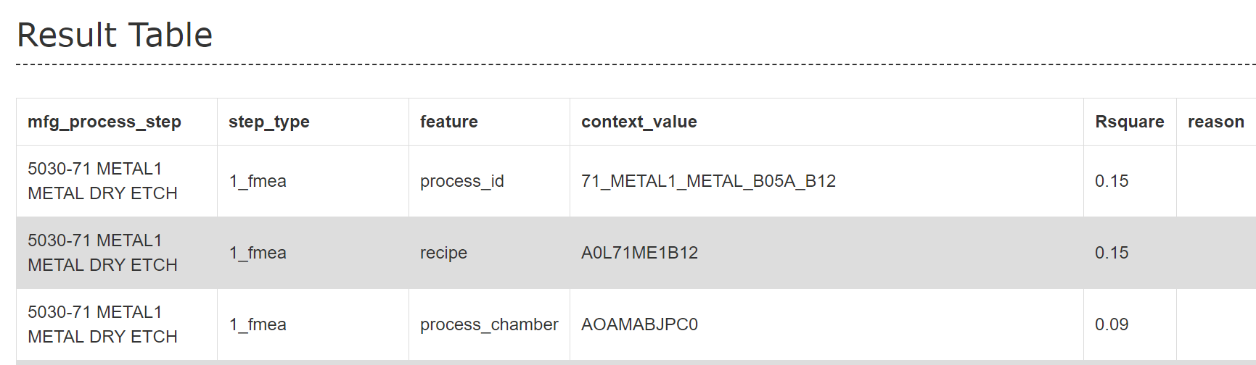
Analysis Method
FMEA List
This feature currently is only available for RDA AD.
A list contains measurement step, process step and corresponding channel id.
This list is prepared by RDA team so far.
AD will check whether channel id is in the list and mark corresponding process step as FMEA step.
FMEA List Example
Measurement Step | Process Step | Channel Id
1000-82 PASS PHOTO MACRO INSP | 3010-82 PASS PHOTO | 716608
1000-82 PASS PHOTO MACRO INSP | 3010-82 PASS PHOTO | 716609
1000-82 PASS PHOTO MACRO INSP | 3010-82 PASS PHOTO | 716610
1000-82 PASS POLYIMIDE ANNEAL 2 WIS INSP | 3010-82 PASS PHOTO | 716616
1000-82 PASS POLYIMIDE ANNEAL 2 WIS INSP | 3010-82 PASS PHOTO | 716617
1000-82 PASS POLYIMIDE ANNEAL 2 WIS INSP | 3010-82 PASS PHOTO | 716618
1000-02 ALIGN MARK INSITU DRY STRIP MICRO INSP | 5200-23 PERIPH OXIDE CMP | 716622
1000-02 ALIGN MARK INSITU DRY STRIP MICRO INSP | 5200-23 PERIPH OXIDE CMP | 716623
1000-02 ALIGN MARK INSITU DRY STRIP MICRO INSP | 5200-23 PERIPH OXIDE CMP | 716624
1000-28 W0 METAL SPUTTER MICRO INSP | 3010-28 W0 PHOTO | 716628
1000-28 W0 METAL SPUTTER MICRO INSP | 3010-28 W0 PHOTO | 716631
1000-28 W0 METAL SPUTTER MICRO INSP | 3010-28 W0 PHOTO | 716632

Slide 15
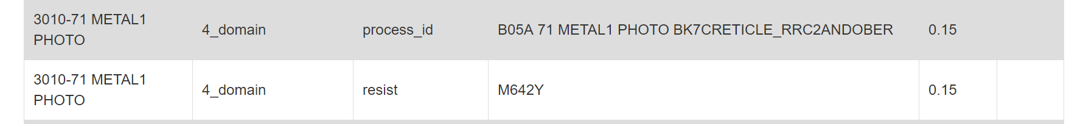
Analysis Method
Domain Knowledge
This feature currently is only available for RDA AD.
A list contains RDA defect parameter and corresponding process step pattern.
This list is prepared by RDA team so far.
AD will check whether defect parameter is in the list and mark corresponding process step as Domain Knowledge step.
Domain Knowledge Example:
“CB_32_RESIDUAL_FILM”: current loop CMP, WP or WET ETCH steps.
“CB 19_RESIDUE”: current loop after PHOTO steps.

Slide 16
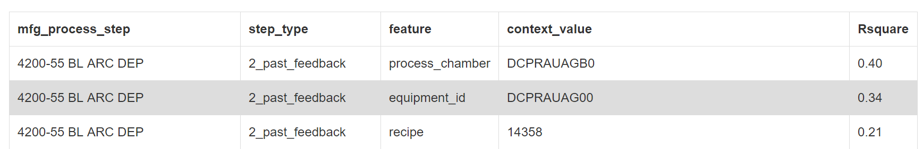
Analysis Method
Past Feedback
This feature currently is available for both RDA AD and Chronic OOC AD.
AD will query past feedback cases for same chart and mark past feedback root cause step as feedback step

Slide 17
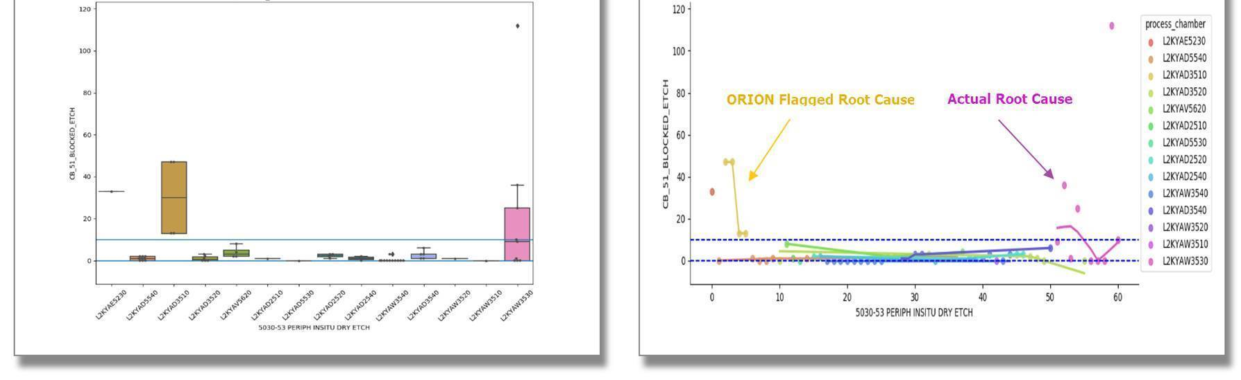
Analysis Method
Last OOC Check
This feature currently is available for both RDA AD and Chronic OOC AD.
AD will focus on the latest OOC.
This method will be depreciated in near future since time weighted correlation is applied.
Only last OOC’s related information will be possible as root cause.

Slide 18
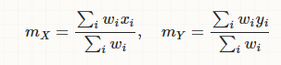
Analysis Method
Time Weighted Correlation
Weighted Correlation (Link)
Equal weighted
Time weighted

Slide 19
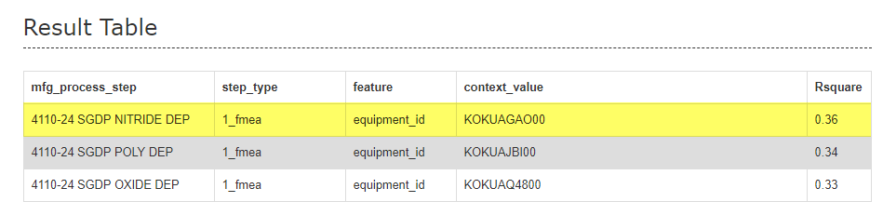
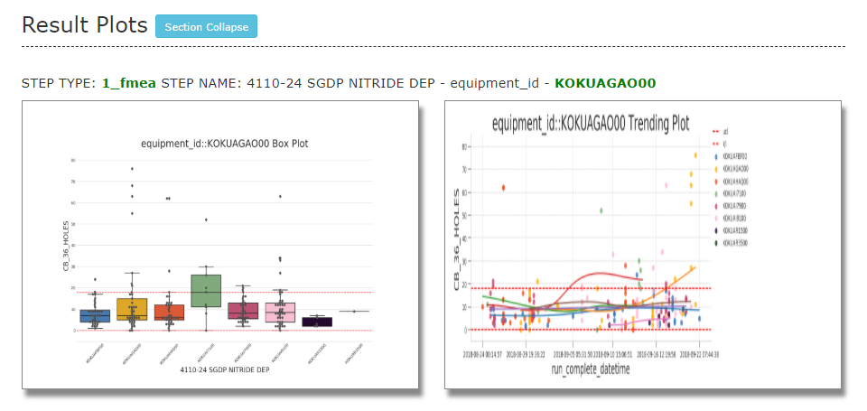
Analysis Method
Time Weighted Correlation
This feature currently is available for both RDA AD and Chronic OOC AD.
AD will focus on the latest OOCs.
Toggles matches in the latest OOC time period will have much higher correlation value than early period.
Current Rsquare value is calculated by this time weighted correlation. The higher Rsquare is, the better match between potential toggles and OOC points.

Slide 20
AD Report

Slide 21
Report
Overview
AD report is built by HTML with JavaScript and CSS technology.
Both RDA AD and Chronic OOC AD share same report template.
It covers below sections:
Title
OOC Chart
FMEA Step (RDA AD only)
Past Feedback
Result
Result plots
Feedback

Slide 22
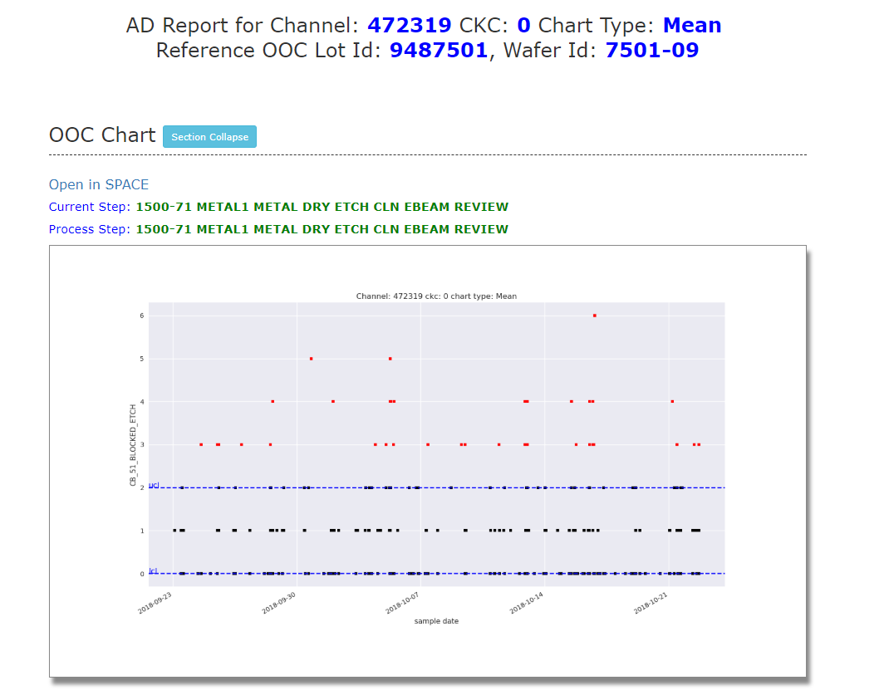
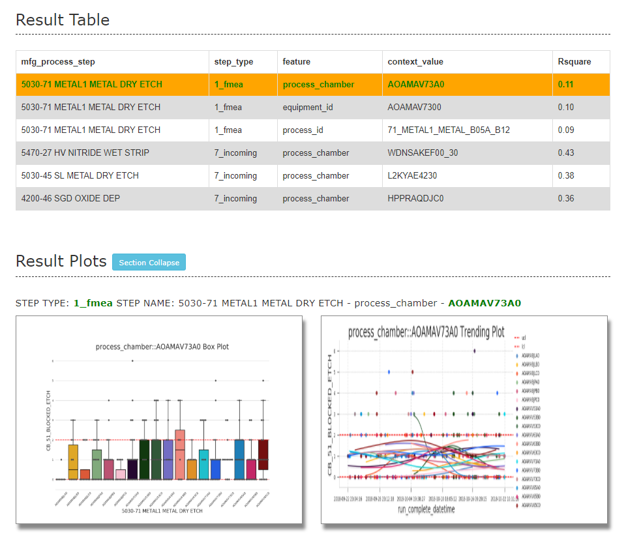
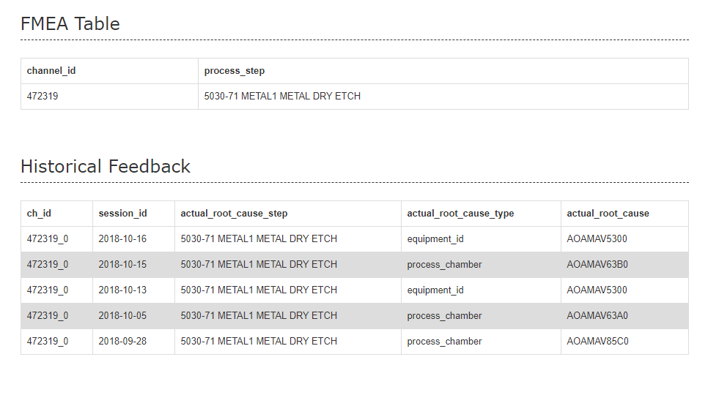
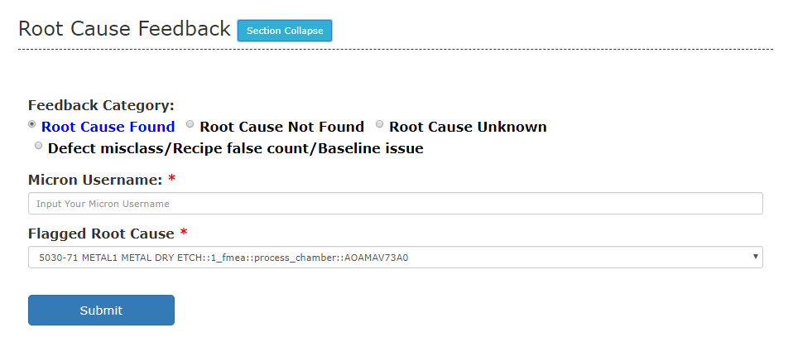
Report
Sections

Slide 23
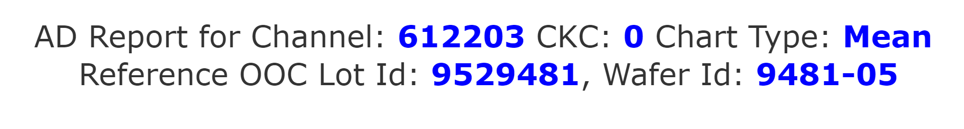
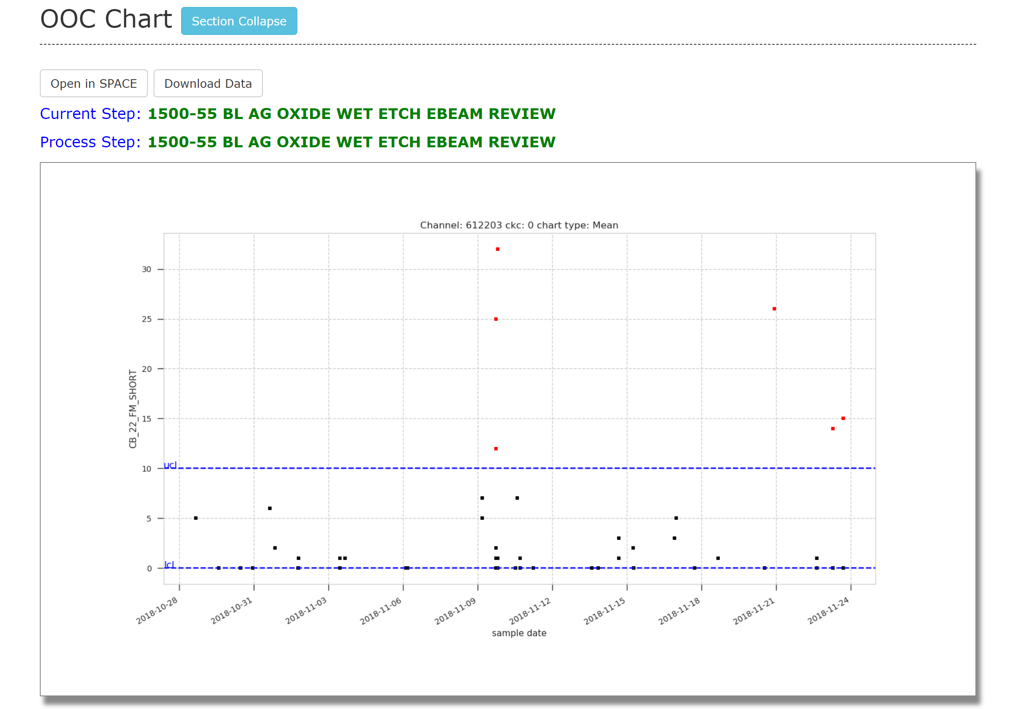
Report
Sections-OOC Chart
For header, it will display the channel, ckc and chart type.
Reference OOC lot is used in last OOC point check
This section will display below information:
Current step: OOC step
Process step: corresponding process step
SPACE chart
Red point: OOC point
Black point: non-OOC point
Blue dotted line: upper control limit and
lower control limit

Slide 24
Report
Sections-FMEA and Historical Feedback
This section will display below information:
FMEA Table: if chart is assigned FMEA step, it will
display corresponding process step
Historical Feedback: if chart got feedbacked before
the analysis, it will display latest 5 feedback.

Slide 25
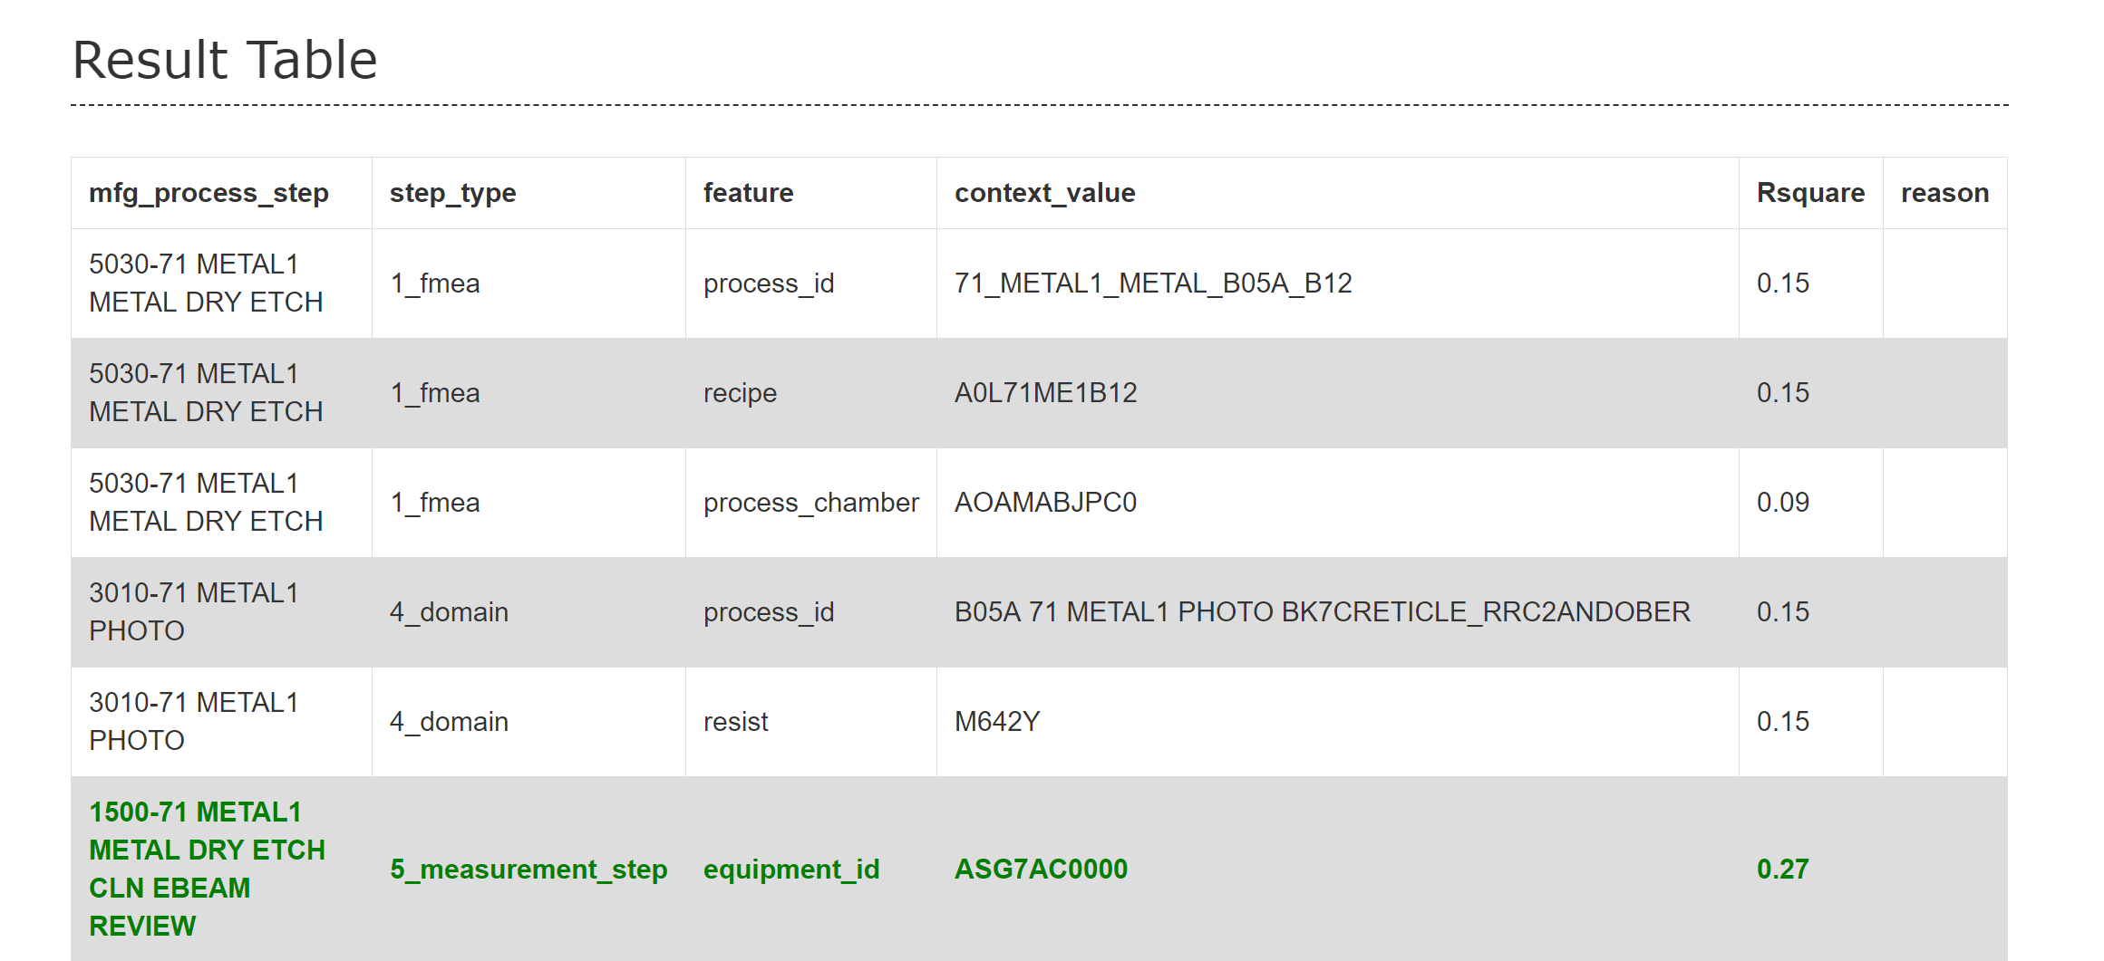
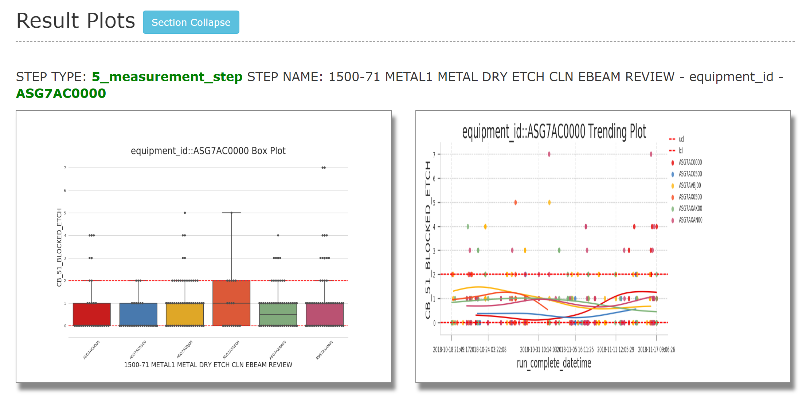
Report
Sections-Result and Plots
This section will display below information:
Result table:
Root cause and correlation value is shown.
Result plot:
Both box plot and trend plot will have same color for
same category.
Box plot: the first box will be colored in red and will be
potential root cause
Trend plot: smoothing method is used to draw the curve.
Smoothing method is similar to Y3 kernel smoothing method.

Slide 26
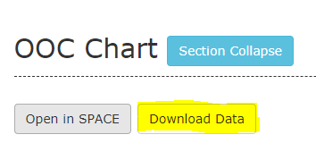
Report
Features
Download Data
This will enable to download data which is used for AD analysis

Slide 27
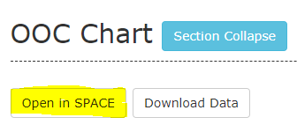
Report
Features
Open in SPACE
This will enable user to open SPACE directly from AD report.

Slide 28
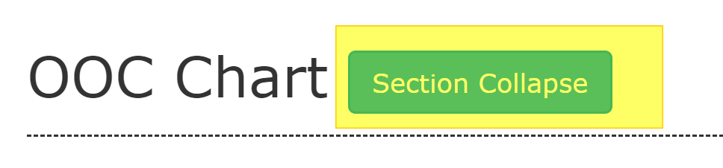
Report
Features
Section Collapse
This will enable user to collapse certain section.

Slide 29
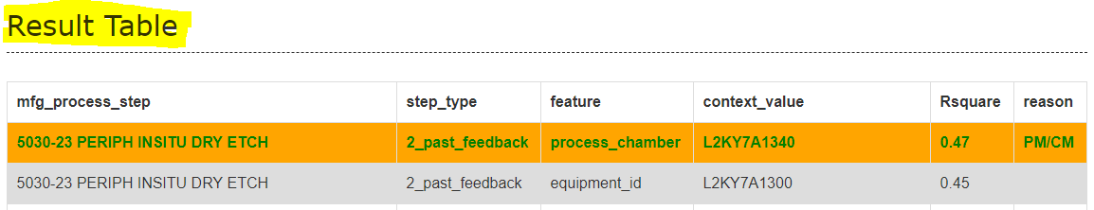
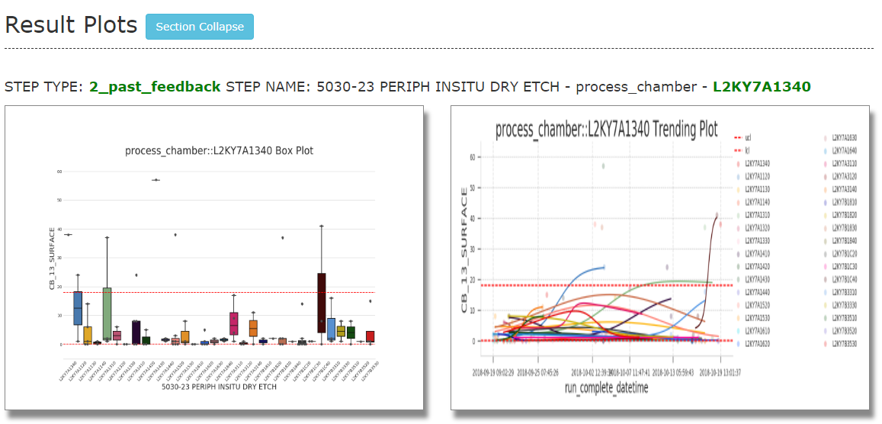
Report
Features
Click to Show Plotting Charts
By default, the plots section only show top 3 results’ plots. Other plots user need to click on result table.
Click one row in Result Table
Plotting charts will be shown in Result Plots

Slide 30
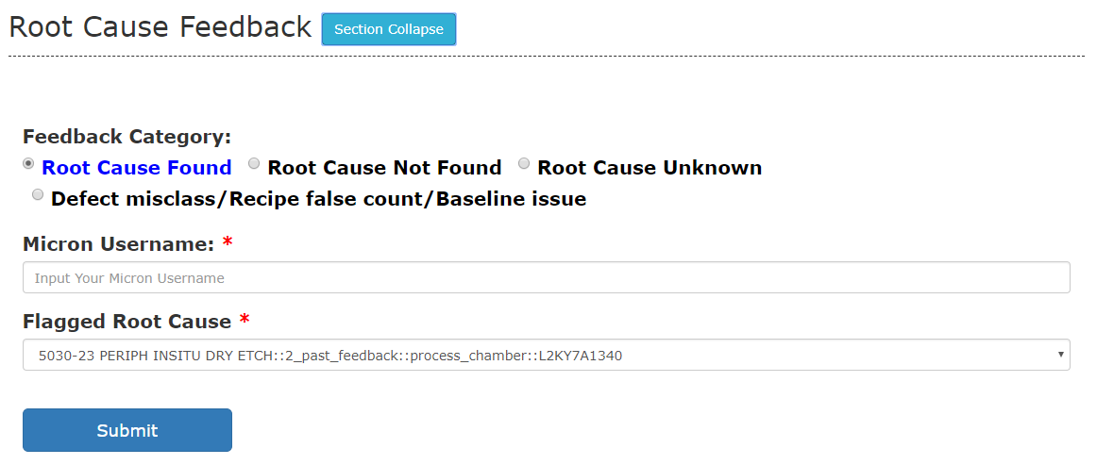
Report
Feedback
Actual Root Cause Feedback
This will enable user to give accuracy feedback directly in report.
4 types of feedback can be given
Root cause found: root cause is in the result table
Root cause not found: root cause is not in the result table
Root cause unknow: user cannot identify root cause
Defect misclass/ Recipe false count/ Baseline issue: chart related issue

Slide 31
Dashboard

Slide 32
Dashboard
SPC Chronic OOC dashboard can view AD report directly.
Both RDA AD and Chronic OOC AD has another dashboard to track AD analysis status and also view feedback status.
AD analysis tracking by color
AD feedback tracking
AD accuracy tracking
Link
RDA AD:
Chronic OOC AD:
F10W
F10N

Slide 33
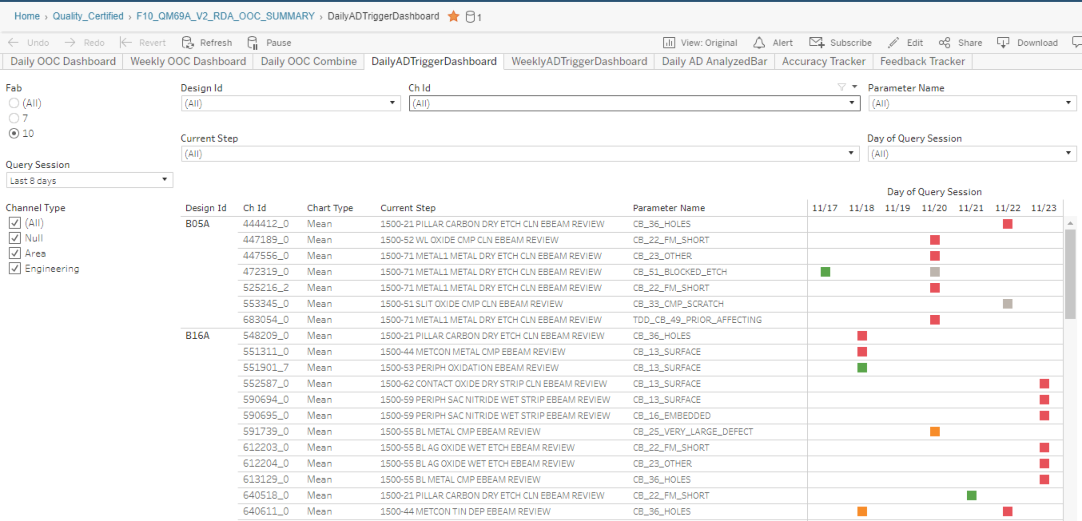
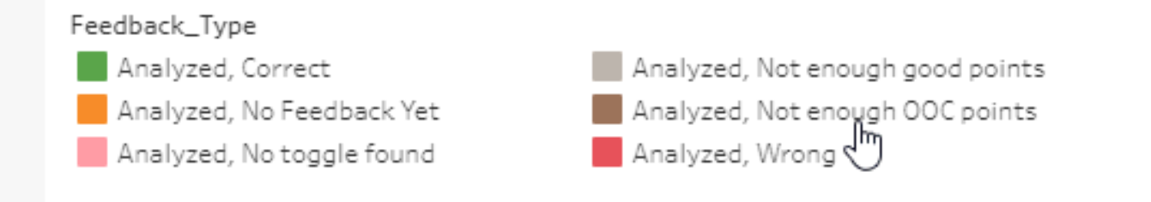
Dashboard
AD analysis tracking by color
Different color shows status of Analyzed/ Not Analyzed and Feedbacked/ Not Feedbacked.
Click this to refresh the dashboard
and see latest feedback status
Click this will show
the AD report

Slide 34
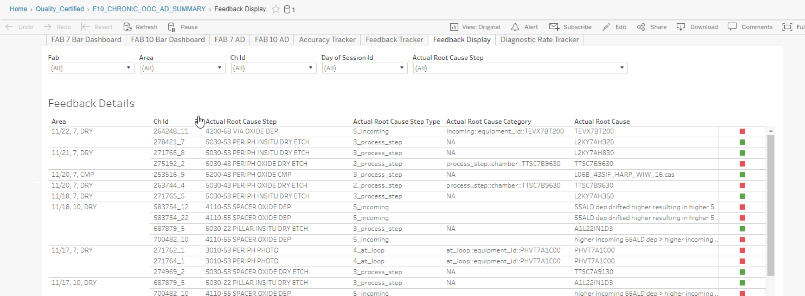
Dashboard
AD analysis tracking by color
This tab will show the past feedback by user.

Slide 35
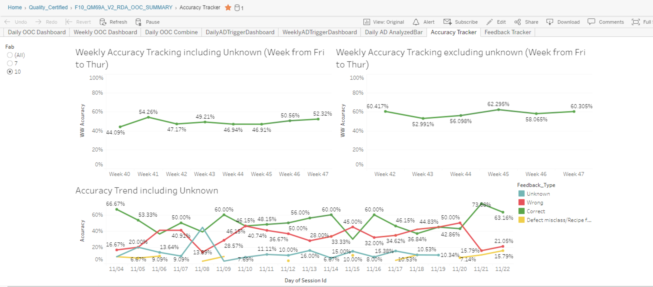
Dashboard
AD accuracy tracking
This tab will show the weekly and daily accuracy tracking.

Slide 36
Future Plan
Raw chart type support
Channel level analysis for incoming toggles
DF recycle history analysis.
FD analysis
Merge all algorithm into ORION AD.

